Slide 1
Object Oriented Concepts and Java Implementation-1

Slide 2
Review
Java has built-in data types, known as primitive data types.
Variables are basic units of storage.
Casting is a facility of converting a data type to another data type.
Arrays are used to store several items of same data type in consecutive memory locations.
Java provides different types of operators. They include:
  Arithmetic
  Relational
  Logical
  Conditional
  Assignment
Java supports the following programming constructs for the control statements:
  if - else
  switch
  for
  while
  do - while
The two jump statements, break and continue, helps to transfer control to another part of the program.

Slide 3
Objectives
Explain Object
Explain Class
Explain abstraction and encapsulation
Explain the relationship between Object and Class
Design an example to create class and object
Describe components of a class

Slide 4
Object Oriented Programming
OOP
Designed to model real world
concepts using a computer program
All real world things are considered as objects in OOP
Enables modeling of real world
entities into similar entities
using a computer
Method of designing and
implementing software systems

Slide 5
Object
Object
Core of Object oriented
programming
Represents an entity in the real world
“An object is a concrete entity that exists and which has a well defined state and behavior.”
Provides practical basis for computer applications
Accomplishes
specific tasks

Slide 6
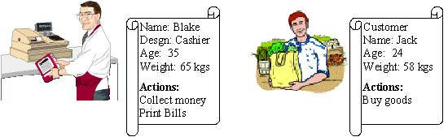
Example of an Object
Cashier Object
Customer Object
State
Behavior

Slide 7
Message Passing
Message Passing
Objects communicate with each other by passing messages
When a particular operation is to be performed, it is requested for by sending a message to the object for which the operation is define
“A message is a request sent by one object to another object to carry out certain actions.”

Slide 8
Class
A Class defines an entity in terms of common characteristics and actions.
Class is a mechanism used to group properties of actions common to various objects.
Examples of Classes
Class of Cars
Class of Shapes
Class of Animals
“A class is a blueprint for a group of objects that have common properties and behavior.”

Slide 9
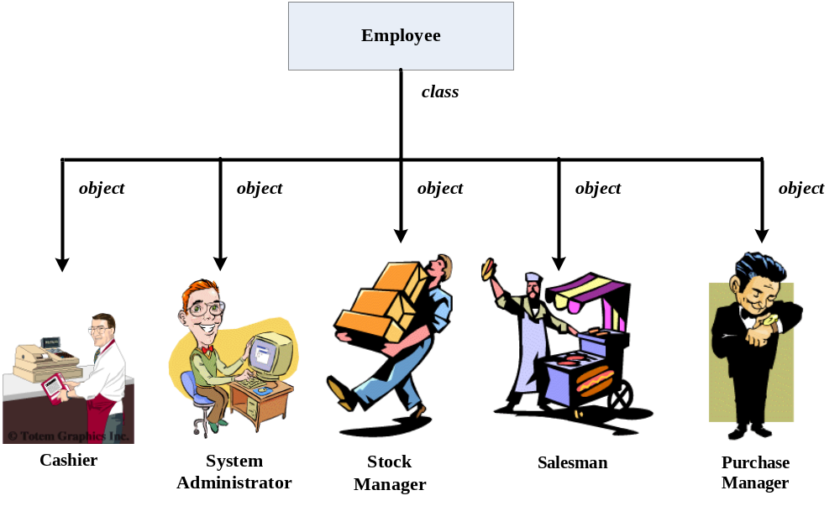
Example of Class and Object

Slide 10
Properties or Attributes
Characteristics of objects represented as variables in a class.
Each object has its own value for each of its properties.
The property names are shared by all instances of a class.
Name
Salesman Object
Address
Properties
Age
“A characteristic possessed by an object or entity when represented in a class is called a property.”

Slide 11
Methods
Methods
Actual implementation of an operation
Methods specify the manner in which the data of an object is manipulated
“An action performed by an object is known as a method.”
Specification of how the requested operation is carried out

Slide 12





Example of Method
stitchClothes
Method
Take Measurement
Steps for stitching clothes
Stitch clothes
Get Instruments

Slide 13
Difference between Class and Objects
Class and Objects
Class defines an entity
Object is the actual entity
Class is a conceptual model that defines all the characteristics and actions required of an object
All objects belonging to the same class have the same characteristics and actions

Slide 14
Encapsulation
Information Hiding
Hiding implementation details of an object from its user
Packing things together and presenting them in their new integrated form.
For example, two or more chemicals form a capsule
Packing the methods and attributes together in a single unit.
Units are implemented in the form of classes
“The process of hiding attributes, methods or details of implementation is called Encapsulation.”

Slide 15
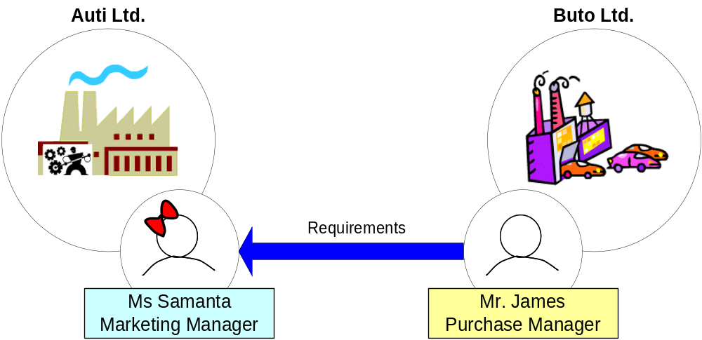
Example of Encapsulation 3-1
Interfaces

Slide 16
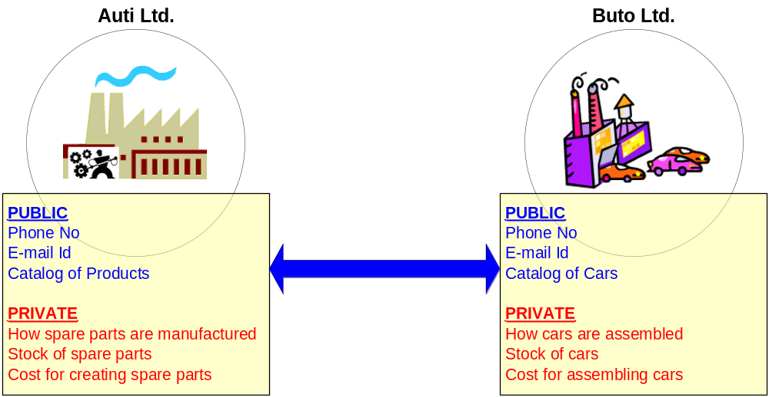
Example of Encapsulation 3 - 2
Selective Availability of Data

Slide 17
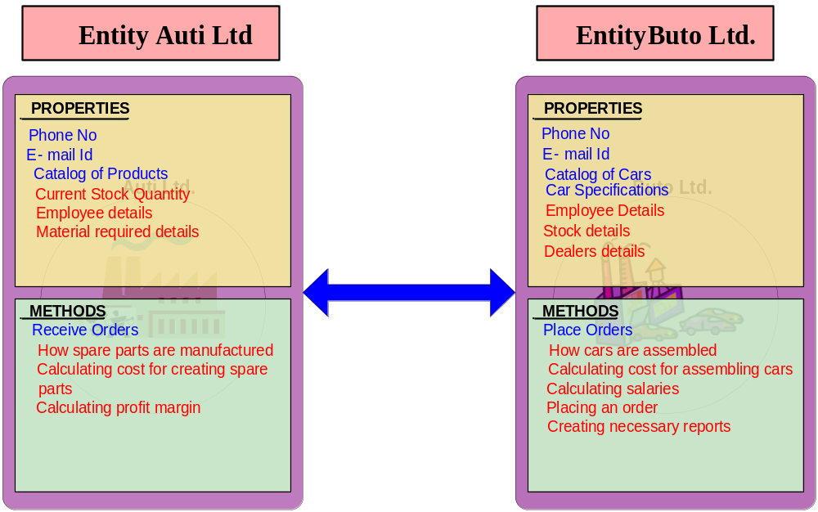
Example of Encapsulation 3 - 3

Slide 18
Abstraction
Technique of dealing with the complexity of an object.
Focussing only on the essential details and overlooking the non-essential details of an object.

Slide 19


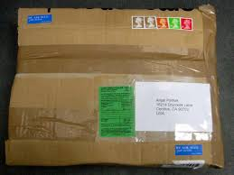

Example of Abstraction
Carrier Courier Company
Hands over report
Hands over acknowledgement receipt
Dr. Smith
Report is packed and sealed
Gets acknowledgement receipt signed
Report sent to destination

Slide 20
Data Abstraction
Concept of abstraction applied to the attributes (data) of a class.
Implemented in programming languages using Abstract Data Types (ADT).
“The process of identifying and grouping attributes and actions related to a particular entity as relevant to the application is Data Abstraction.”

Slide 21
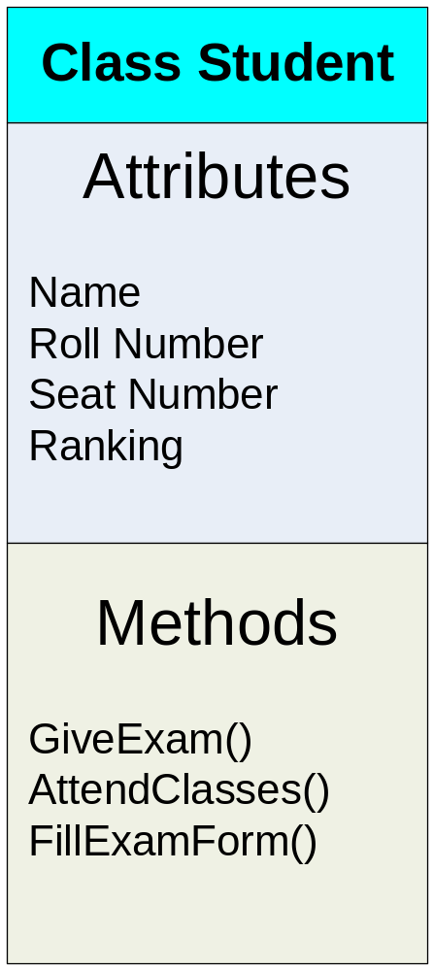
Example of Data Abstraction

Slide 22
Implementing Classes in Java
Syntax
class <classname> {
<body of the class>
}
where,
class is the keyword used for creating a class,
<classname> is the name of the class, and
<body of the class> consists of declaration of attributes and methods.

Slide 23
Methods in classes 5-1
Name of the method
Method
Definition
Type of object or primitive type that the method returns
Body of the method
List of parameters

Slide 24
Methods in classes 5-2
Syntax
<returntype> <methodname> (<type1> <arg1>, <type2> <arg3,…) {
<set of statements>
}
where,
returntype is the data type of the value returned by the method,
<methodname> is the user-defined name of the method, and method’s parameter list is a set of variable declarations.

Slide 25
Methods in Classes 5-3
class Book {
String bookName;
String authorName;
int nopages;
boolean available;
void isAvailable() {
if(available == true)
System.out.println("The Book is available");
}
…
method

Slide 26
Methods in Classes 5-4
Methods are accessed using dot notation.
Object whose method is called is on the left of the dot, while the name of the method is on the right.
For Example,
  Obj.isAvailable();
Java provides class methods, which are similar to instance methods.
Class method declaration is preceded with a static keyword.

Slide 27
Methods in Classes 5-5
class Book {
String bookName;
String authorName;
int nopages;
boolean available;
}
static void isAvailable() {
if(available == true)
System.out.println("The Book is available");
}
Book objBook = new Book();
objBook.isAvailable();
…..
Dot notation

Slide 28
this Keyword
Used inside any instance method to refer to the current object.
The value of this refers to the object on which the current method has been called.
The this keyword can be used where a reference to an object of the current class type is required.

Slide 29
Example of this Keyword
class pixel {
int x,y;
void init (int x, int y)
{
this.x = x;
this.y = y;
}
}
public static void main (String args[])
{
pixel p = new pixel();
p.init (4,3);
}
Reference to an object
The program initializes x = 4 and y = 3.

Slide 30
Constructors 4-1
Method invoked whenever an instance of a given class is created.
Same name as the class and no return type.
Java allocates memory for the object, initializes the instance variables and calls the constructor methods.
Two types of constructors
  Parameterized constructors
  Implicit constructors

Slide 31
Example of Parameterized Constructors
Constructors 4-2
Sdate(int m,int d,int y) {
month=m;
day=d;
year=y;
System.out.println("The Date is " + m + "/" + d + "/" + y + ".");
}
public static void main(String args[])
{
Sdate S1,S2;
S1=new Sdate(11,27,1969);
S2=new Sdate(3,3,1973);
}
Parameterized Constructor

Slide 32
Example of Implicit Constructors
Constructors 4-3
Sdate()
{
month=11;
day=27;
year=1969;
}
public static void main(String args[])
{
Sdate S1,S2;
S1=new Sdate();
S2=new Sdate();
}
Implicit Constructors

Slide 33
Constructors 4-4
public static void main(String[] args) {
Book objBook = new Book("CoreJava", "Albert", 45, true)
User objUser = new User();
objUser.getBookStatus(objBook);
}
Book(String book, String author, int pages, boolean status) {
bookName = book;
authorName = author;
nopages = pages;
available = status;
}
class User {
void getBookStatus(Book objBook) {
objBook.isAvailable();
}
}
Demonstrate: Example 1

Slide 34
Summary
An object consists of state and a behavior.
A class acts as a blueprint for a group of objects that have the same properties and behavior.
Abstraction is ignoring the data that is not required and concentrating only on data relevant to the application.
Encapsulation is the process of hiding the implementation details of an object from its user.
The variables and methods of a class are accessed by the instances of that class.
Dot notation is used to access members of an object.
A constructor initializes an object when created.

